Slide 1

Algorithmic Stock Trading System
Team Pythia: Clement Cole
Chris Roche
Elijah Adedapo
Enrique Torres

Slide 2
Project Overview:
Algorithmic Stock Trading System
Select an algorithm for stock value prediction
Implement the algorithm in hardware (FPGA)
Implement the algorithm in software (C++)
Pull historical stock data from Yahoo Finance and put it in a database
Send stock analysis results to the web-based user interface

Slide 3
Current Status:
Algorithmic Stock Trading System
Algorithm selection: Genetic
Historical data retrieval completed in Python using Yahoo Finance API
SQL database being developed to hold stock data
Software implementation completed in Python and being rewritten in C++
Hardware implementation has just begun
Very basic web-based user interface completed

Slide 4
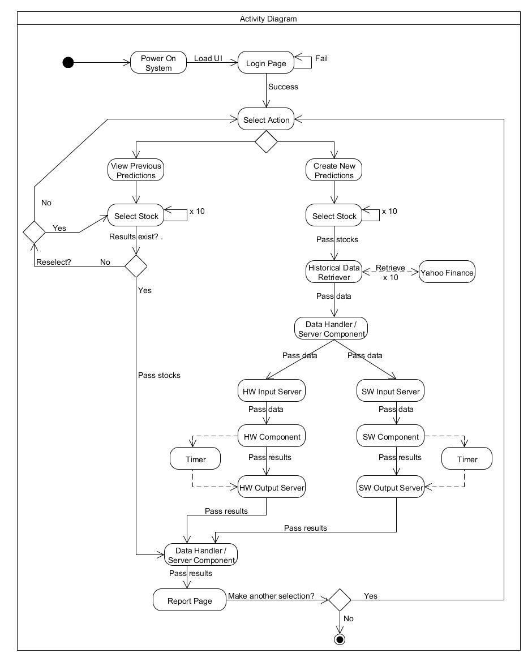
System Overview:
Algorithmic Stock Trading System
Historical stock data retrieved prior to market open; daily
Algorithm is ran in HW and SW
Performance data is captured for each implementation
User interface displays:
Price predictions
Trends
Performance data

Slide 5
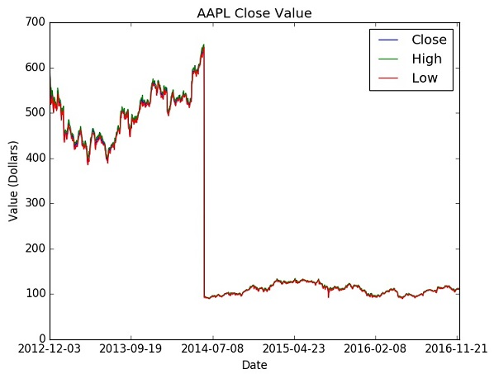
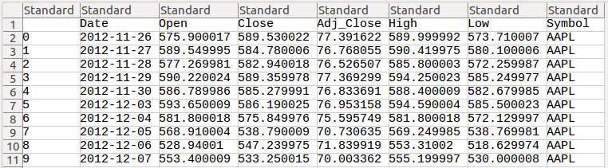
Data Retrieval
Algorithmic Stock Trading System
Yahoo Finance API
Data stored in CSV
Graphs generated

Slide 6
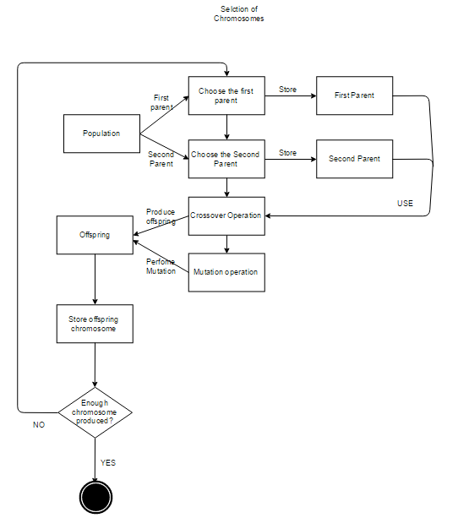
Algorithm Overview:
Algorithmic Stock Trading System
Genetic Algorithm
Create initial population
Evaluate fitness of individuals
Selection
Crossover
Mutation
Generate new population
Repeat

Slide 7
Genetic Algorithm
Algorithmic Stock Trading System
Selection
…
…
Crossover
…
…
Mutation
…
…

Slide 8
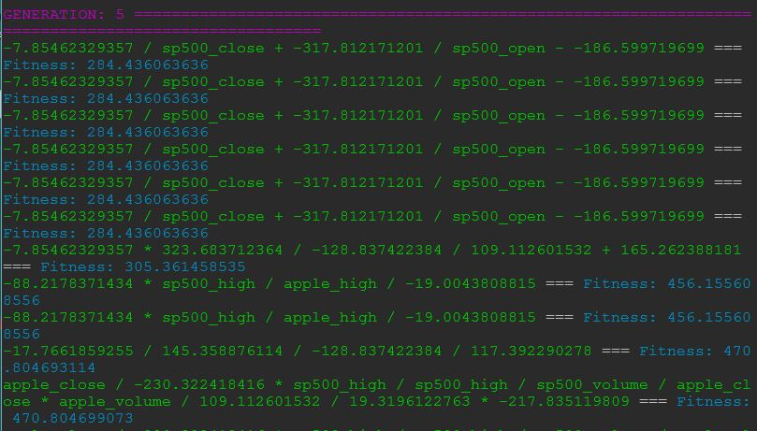
Sample Output
Algorithmic Stock Trading System

Slide 9
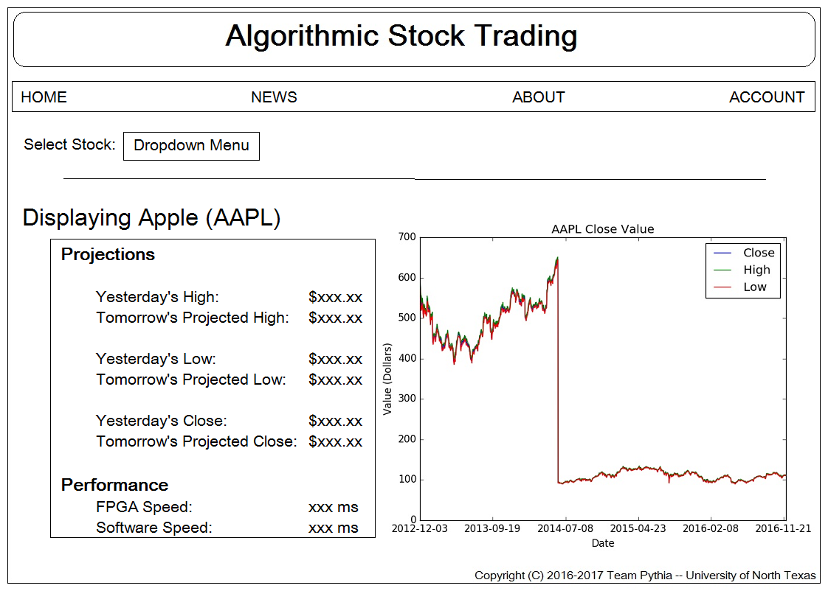
User Interface:
Algorithmic Stock Trading System

Slide 10
What’s Next:
Algorithmic Stock Trading System
Continue development of software implementation.
Continue implementation of genetic algorithm in hardware
Modify basic genetic algorithm to increase accuracy
Increase web interface functionality and aesthetics

Slide 11
Questions?
Algorithmic Stock Trading System

